Slide 1
Physics 201
Winter 2013
Introduction

Slide 2
Science is at the root of all technological innovation
Winter 2013
Research
Design
Nature
Science
Technology
Product
Utility
Invention
Marketing
Material world
Human world
Diagram credit: Managing Technology Innovation by Katz

Slide 3
Democritus was right: physics is all mechanics
Winter 2013
Large
Classical Mechanics
Classical
Field Theory
Newton
Maxwell
Einstein
Slow
Fast
Schrodinger
Dirac
Feynman
Quantum Mechanics
Quantum Field Theory
Small

Slide 4
Physical objects each have their own mode of motion
Winter 2013
Object
Solid
Solid
Fluid
Rigid
Rigid
Elastic
Liquid
Gas
Focus for 201

Slide 5
Our first step is to frame the right question
Winter 2013
Question:
How does a rigid object respond to force?
Answer:
Acceleration, deflection and rotation
Special cases to consider
  Moving or at rest? Constrained or free?
Constrained motion is harder to analyze, so we will deal with unconstrained (free) objects first

Slide 6
Force changes motion, but is not the cause of motion itself
Winter 2013
The property that an object in motion will tend to stay in motion is called inertia
This is called the principle of inertia and is
Newton’s first law of motion
Inertia is quantified in the mass of the object;
this represents how “unresponsive” it is to force

Slide 7
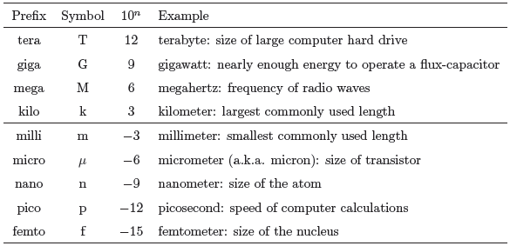
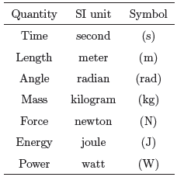
Sidebar:
SI units and the metric system
Winter 2013

Slide 8
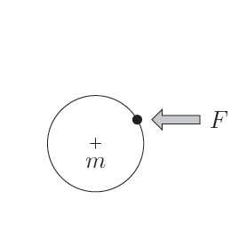
Consider striking a puck on an air hockey table
Winter 2013
Five factors to consider
Mass of the puck
“Center of mass”
Magnitude of the force
Direction of the force
Where the force is applied

Slide 9
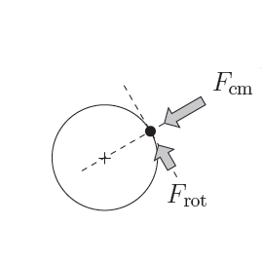
In general, a force has two significant components
Winter 2013
This will make the puck move
Force in line with the center of mass – leads to acceleration
Force perpendicular to the center of mass – leads to rotation
This will make the puck spin

Slide 10
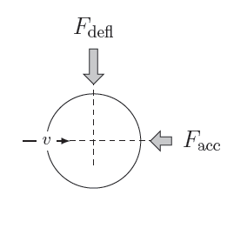
If the puck is moving, a further decomposition is important
Winter 2013
This will deflect the path of the puck
Force in line with the motion – will change speed
Force perpendicular to the motion – will change direction
This will slow the puck down

Slide 11
Our first question leads to three more…
Winter 2013
How do we “decompose” forces?
  We must learn about vectors (involves trig)
How do we identify the “center of mass”?
  This can be a bit difficult – we will spend most of our time ignoring this question ☺
How exactly do these forces create motion?
  Each category of force has a different approach – we will spend most of our time on this question

